Slide 1
Algorithmic Trading System
COSC 471
Computer Science - Okanagan College
2024
Harnessing robust datasets for machine learning and market analysis
Authors:
Jacob Rawlings, Jake Fischer, Alan Abdollahzadeh, Benjamin Carrier, Vanessa Dubouzet, Dominic Presch
Notes:
Good morning… Thank you for joining us today… Introduce… We are excited to present our project - The Algorithmic Trading System - Developed as part of our software engineering class here at okanagan college.

Slide 2
AGENDA
INTRODUCTION 01
SCRIPTS 07
BUSINESS REQUIREMENTS 02
TESTING 08
SYSTEM ARCHITECTURE 03
REFACTORING 09
CONFIGURATION MANAGEMENT 04
LESSON LEARNED 10
RISK MANAGEMENT 05
PROJECT DEMO 11
SYSTEM DESIGN 06
. 12
Notes:
We will walk through some of the challenges and requirements identified, some system design and development work, and a live demo of our project in action at the end.

Slide 3
INTRODUCTION
01
Problem statement, Project Description, Stakeholders, Project Progress
Notes:
Jacob

Slide 4


Our Clients
Gaetan Hains
Computer Science
Teaching, research and doctoral supervision in Computer Science
Albert Wong
Math & Stats
Teaching, SW Engineering and Database Research Group
Notes:
Jacob Publication: Short-Term Stock Price Forecasting using exogenous variables and Machine Learning Algorithms
Link: https://www.researchgate.net/publication/373686269_Short-Term_Stock_Price_Forecasting_using_exogenous_variables_and_Machine_Learning_Algorithms

Slide 5







The Problem
Manual Collection
- Requires man-hours
- Susceptible to mistakes
Limited Dataset
- Impacts model accuracy and scope
Maintainability
- Difficult to scale and maintain
Our Project
The Algorithmic Trading System (ATS) project was developed to address these shortcomings.
Automation
API & Database
User Interface
Notes:
Jacob
The Problem: Let’s dive into the current challenges faced by our clients. As of right now, the data research team is gathering a small dataset of only a few stocks. This is done manually, which is slow and prone to human errors. This is far from ideal due to the volatility of the stock market, and was insufficient in producing the most accurate model possible. Scaling this up in the future would also be a huge challenge.
Our Project: The Algorithmic Trading System project is aimed at overcoming these limitations. We were tasked with engineering a maintainable and configurable system, which utilizes automation, API calls, database storage, and a user-friendly interface in order to improve our client’s ability to effectively train their Stock Market Forecasting machine learning model.

Slide 6
Project Progress
FIRST SEMESTER
SECOND SEMESTER
During the initial semester, the entire class collaborated on this project, laying the groundwork with documentation and developing the system pipeline
This semester, half of the class joined the new IH project, while the rest of us continued our work on this project. Let's now discuss the new implementations we've made.
Sep/2023
Dec/2023
Jan/2024
Apr/2024
Notes:
Jacob

Slide 7
BUSINESS
REQUIREMENTS
02
Executive Summary, System Users
Notes:
Jacob

Slide 8


Executive Summary
Enriching machine learning models with data-driven insights
Objectives:
Automate the collection, processing, and storage of financial assets
Develop the software to be scalable and maintainable
Design and deploy a straightforward, web hosted user interface for analysts to interact with
Impact:
Enriches ML models ability to generate reliable market forecasts
Gives market researchers improved tools for their analysis strategies
Notes:
JACOB:
At its core, the Algorithmic Trading System (ATS) seeks to solve a critical problem faced by financial market analysts - the need for expansive and reliable datasets.
Objectives:
Automate the collection, processing, and storage of financial assets
Develop the software to be scalable and maintainable
Design and deploy a straightforward, web hosted user interface for analysts to interact with the system
Impact:
By providing ML models with accurate and comprehensive data, ATS enriches their ability to generate reliable market forecasts. And by extension, giving market researchers improved tools for their analysis strategies.

Slide 9

Stakeholders
Primary Stakeholders - System Administrators
Maintain and manage the system
Integrate data with ML models
Secondary Stakeholders - Students / Basic users
Export collected data
Tertiary Stakeholders - Market Analysts
Concerned with market forecasts produced by ML models
Notes:
Jacob
Now i’ll take a second to talk about the people that make the project meaningful - the stakeholders! First, we have system administrators. They will manage and oversee the ATS on a day-to-day basis, and be responsible for integrating the system with machine learning models. Then we have the basic user, students, who will have access to data exporting. Our system will allow students to engage with up-to-date real world data. And finally Market Analysts, who are concerned with the accuracy of data, and will use the machine learning forecasts to broaden their market prediction strategies.

Slide 10
SYSTEM ARCHITECTURE
03
Architecture Overview, System Architecture

Slide 11


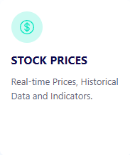
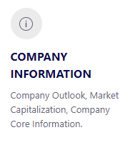
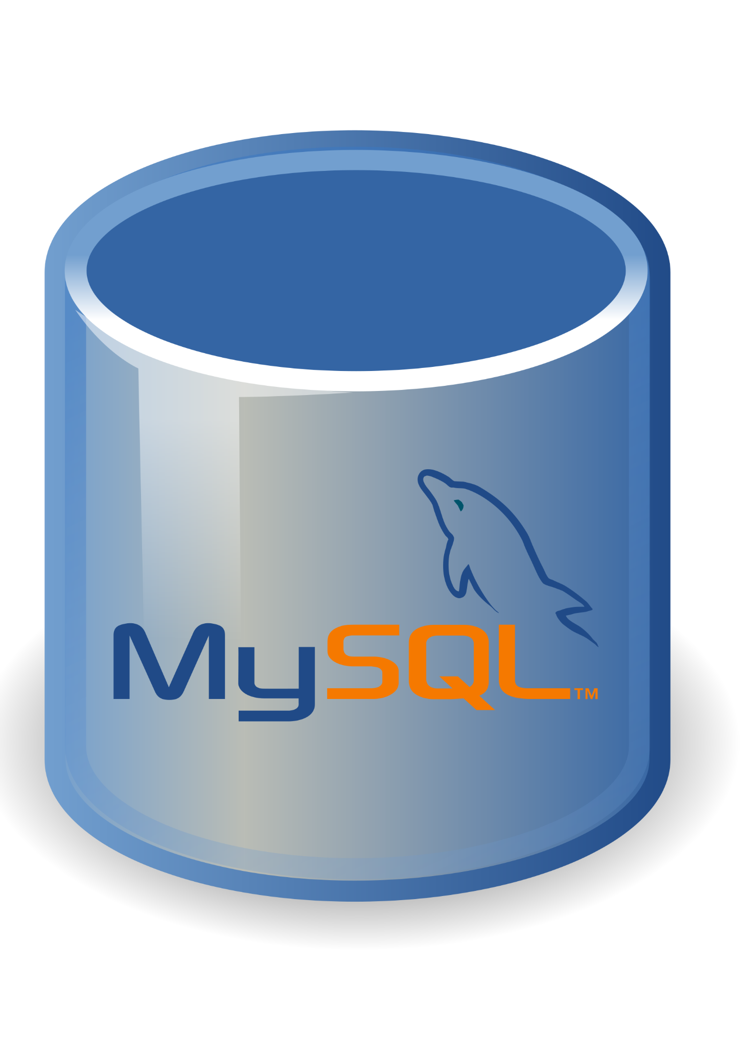




Overview
The ATS consists of several major components in order to function. This includes:
External data source (Financial Modelling Prep API)
Configuration files
Automatic data collection
Data processing and validation
OLTP database storage
User interface
Notes:
JACOB:
Overview:
The ATS consists of several major components in order to function. This includes:
External data source (Financial Modelling Prep API)
Provides stock, index, commodity prices, and bond rates
Configuration Files
Modifiable YAML configuration, allowing users to set system parameters
Automatic data collection
Series of independent python scripts for API calls
Data processing and validation
Python scripts in tandem with SQL libraries used to inject into the database
OLTP database storage
MYSQL database Hosted by third party (IONOS), but DDL could be moved anywhere. Currently also works without IONOS, by using the servers hosted at the college.
User interface
ATS web user interface, users can log in with valid credentials.

Slide 12
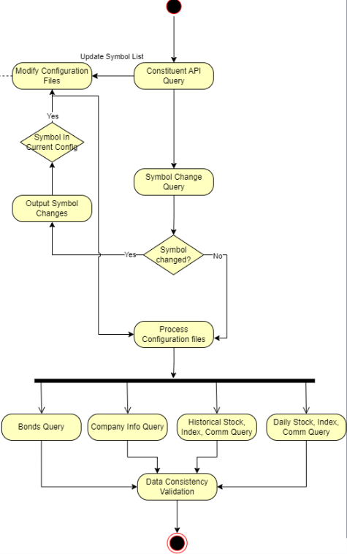
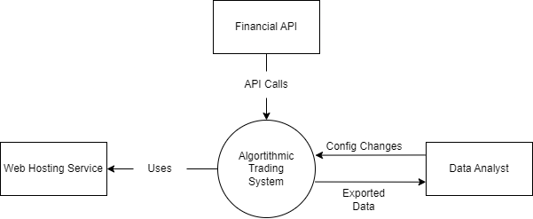
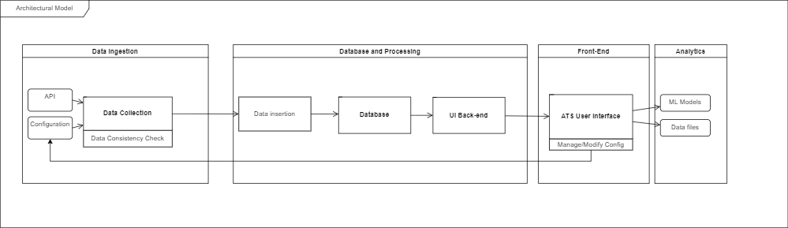
System Architecture
System context [F1]
Data Collection Activity [F3]
Basic top-level architecture [F2]
Notes:
JACOB
The system architecture can be described as a type of modular data pipeline. As mentioned before, the ATS is segmented into distinct modules or components, each responsible for a specific portion of the functionality. This can be broken up into the segments: “Data Ingestion”, “Database and Processing”, “Front End”, and “Analytics”.
Data flows through the pipeline linearly, starting from the API and ending with CSV data files. However, each module of the pipeline operates independently, which gives flexibility in how data is handled at each stage. A good example of this in practice is when we moved from JSON to YAML configuration. That change affected the data ingestion component, but did not impact any other stage of the process.
Having loosely coupled modules also means that we can scale components individually if needed. If the database needs to be upgraded, or if data processing needs more robust features, it won’t significantly affect the data collection or user interface components.

Slide 13
CONFIGURATION MANAGEMENT
04
Project Roles, Project Plan, Continuous Integration
Notes:
Dom

Slide 14




Project Plan
For the continuation of the project we used Agile and the rational unified process.
Inception Phase
Elaboration Phase
Construction Phase
Transition Phase
Maintenance
Tracking the development of the ATS.
Jira
Github
Google Drive
Confluence
Requirements
Planning
Inception
Final testing
Polishing
Analysis
Design
Maintenance
Elaboration
Integration Testing
Deployment
Transition
Construction
Development
Documentation
Notes:
For the continuation of this project we used rational unified process.
Inception Phase: Gathering requirements for added functionality.
Elaboration Phase: Designing the new functionality and determining risks.
Construction Phase: Developing the system with the new functionality, and documentation. Split up into three phases.
Transition Phase: Deploy the system onto the production environment.
Maintenance: Tweak the system to work as intended on the live environment.
Tracking the development of the ATS.
Jira: Provided work flow via work ticket creation and time tracking.
Github: Version control for the code base.
Google Drive: Centralized system documentation storage
Confluence: Holds meeting notes and client discussions for the project.

Slide 15

Project Roles
SCRUM MASTER
PRODUCT OWNER
Jake Fischer
Jacob Rawlings
Monitors, reviews and approves change requests
Ensures the project roadmap aligns with goals
DEVELOPER
CHANGE CONTROL BOARD
Alan Abdollahzadeh, Vanessa Dubouzet,
Ben Carrier, Dominic Presch
Compromises of Product Owner, Scrum Master, and Development Team
Review and approve all Software Change Request
Adheres to version control procedures. Provide feedback on change requests
Notes:
Dom
Scrum master: Directs the teams into what work is getting done each week.
Product Owner: Holds the idea of the product as described by the clients, and lets the team know what needs to be done and what is more important to our clients.
Developers: Create and test the system and bicker.

Slide 16

Documentation
SOFTWARE PROJECT
MANAGEMENT PLAN
RISK MANAGEMENT PLAN
Defines what the project is about and the steps involved in organising its structure
Quantifies the risks and responses while creating and running the product
SOFTWARE DESIGN
BUSINESS CASE
Outlines the boundaries of what the software interacts with
Describes how the project will address business concerns
SOFTWARE TEST PLAN
Outlines the testing structure used to test the system and its parts
Notes:
Dom

Slide 17
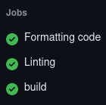
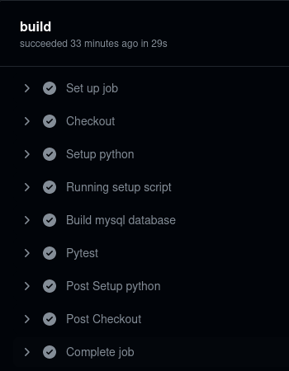
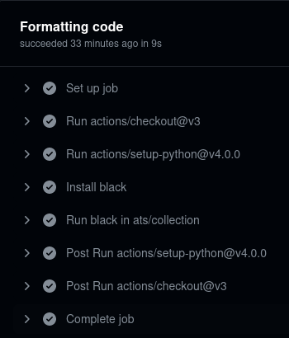
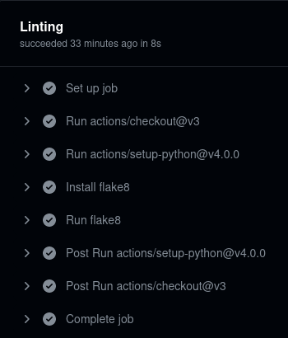
Continuous Integration
Github Actions
Formatting code:
Reformatting python files using Black.
Linting:
Linting the python files with Flake8.
Build:
Running the system on a cloud ubuntu VM.
Build the database and run the tests.
Notes:
Dom
We used github actions for our continuous integration
Every time we made changes to the system it would test the proposed changes and give a report on system activity.
Black: Checks and formats python code to python standards and for better readability.
Flake8: Checks python code for errors and styling issues.

Slide 18
RISK MANAGEMENT
05
Risk Management Overview
Notes:
Dom

Slide 19

Risk Management Overview
How can we handle unexpected system behavior?
RISK
MITIGATION STRATEGY
Application server goes offline
System is will be inaccessible
Have another server running for redundancy
Data Corruption
Potential loss of data
Create database backup procedures
Exceed API rate limit
Data may not collected
Periodic audits of collected data, system logging
Scheduled jobs fail to run.
System is will be inaccessible
System logging and alerts for failed jobs.
Unauthorized UI access
Potential execution of sensitive operations
Implement strong user authentication and validation, add access level security
Notes:
Dom
Jacob’s notes:
Risk management is a vital activity in software engineering. For the ATS, there are a number of risks that we identified could cause problems for the system, and these had to be considered when designing the product. So, we devised mitigation strategies to help prevent or minimize the impact of each risk.
Some of these risks are: [slide]
The key to risk management is continuous monitoring and the ability to adapt to changes as needed.

Slide 20
SYSTEM DESIGN
06
Database Design, User Interface Design
Notes:
JAKE
Hello everyone, for those who don’t know me I am Jake, I was scrum master and developer for the project.
I am going to talk a little bit about the design of the system.

Slide 21
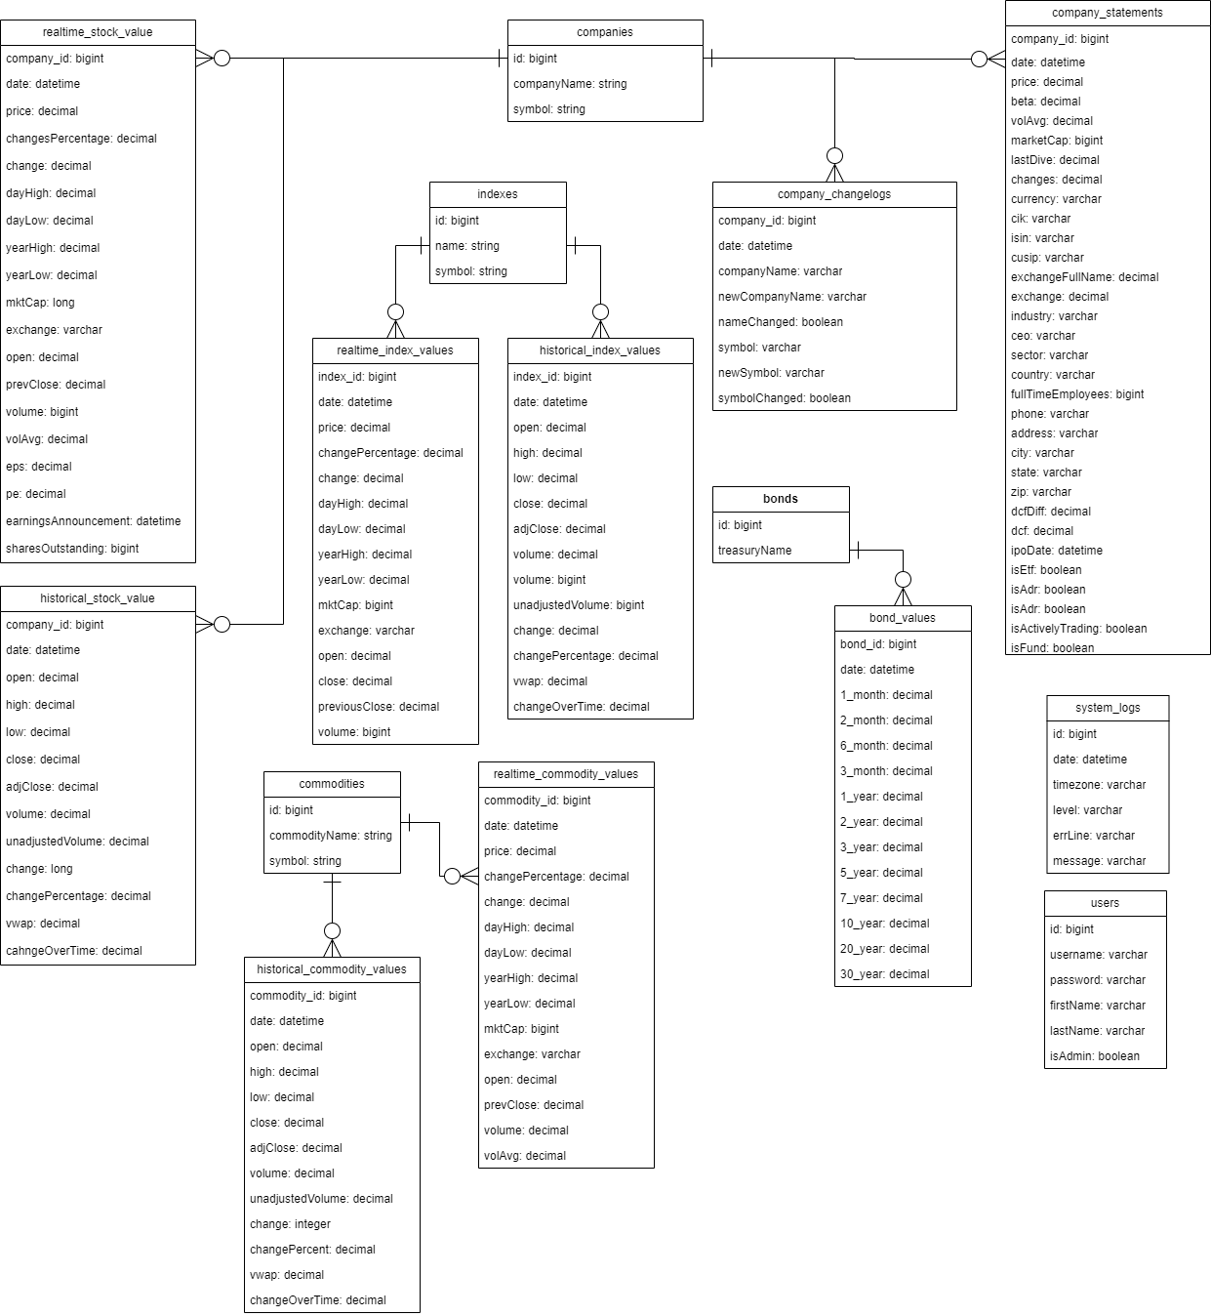
Database Design
Notes:
JAKE
Here is a quick look at our database schema diagram
Detailed descriptions of the database and it’s tables are included in the system documentation.

Slide 22
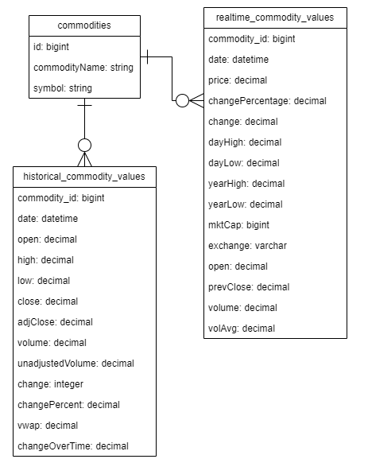
Database Design Consideration
Relationships:
Data retrieved from the API is split up into:
Company/Stock data (realtime and historical)
Commodity data (realtime and historical)
Index composite data (realtime and historical)
Bond data
Each data type has a lookup table and values tables
Triggers:
Unique ID generation triggers
Symbol change trigger
Notes:
JAKE
Here are some of the design considerations that were implemented for the database
Data collected from the API is split into:
Data related to companies and stocks
Data related to commodities
Data related to index composites
And data related to bonds like the US Treasury
Each type of data will have a lookup table and corresponding values tables with a one to many relationship
Since things like stock symbols and company names are prone to change, this was necessary to implement to prevent any update anomalies from happening
Stock, index, and commodity values are split up into realtime and historical tables.
This decision was made because the data source returns different output for both types of data.
Triggers are attached to the database for ID generation
For example, when the system encounters a new commodity such as crude oil, a trigger fires that creates and returns a unique ID for that commodity
After the id is generated, a record will be inserted into the commodities lookup table, and value record can be inserted as normal.

Slide 23


User Interface - Technologies
Front-end:
Javascript
Jinja2 Templating
Bootstrap
Back-end:
Flask
Notes:
JAKE
For front-end technologies we used
Javascript for client side operations
Jinja2 templating for structure
And Bootstrap as our CSS framework
We decided to use bootstrap because we were already familiar with it.
It also provides easy to implement responsive design
We used Flask to handle all of our backend operations
Due to the rest of our project being written in python, Flask was an easy choice being that it's a python based web framework
Other reasons for choosing Flask are:
It provides modules that automatically handle things like user authentication and session management
It is relatively easy to learn and work with.

Slide 24




User Interface - Deployment
Client
Web Server
WSGI Server
ATS UI
HTTP
NGINX
Gunicorn
Flask
Notes:
JAKE
Here is a high level overview of how our flask application is deployed in our production environment.
We are using NGINX as web server and reverse proxy
Gunicorn is web server gateway interface, which acts a as a middle man between the web server and our application.
In order for clients to access our application they:
Send http requests to the NGINX reverse proxy
NGINX then forwards these requests to Gunicorn server, which provides an interface to the application.

Slide 25
Design & File Structure
Templates
Designed to provide modularity to the front-end
Blueprints
Scripts to modularize back-end functionality for the application
Provide routing to HTML templates
Models
Pythonic representation of the ATS database stored in models.py
Used to be interacted with by Flask
Initialization and Execution
App initialization is done in __init__.py
App is executed via wsgi.py
📦ATS_Project_2024
┣ 📂ui
┃ ┣ 📂output
┃ ┣ 📂static
┃ ┣ 📂templates
┃ ┣ 📜auth.py
┃ ┣ 📜configuration.py
┃ ┣ 📜data_export.py
┃ ┣ 📜decorators.py
┃ ┣ 📜job_scheduling.py
┃ ┣ 📜models.py
┃ ┗ 📜__init__.py
┗ 📜wsgi.py
Notes:
JAKE
On the right is an outline of the directory structure for the ATS user interface
The files are split up into 5 main categories:
Static files, which are files such css and javascript files
HTML templates, to allow the easy addition or removal of UI pages
Flask blueprints used to organize and break up UI functionality into separate files
For example auth.py is a blueprint that handles user authentication and validation.
Models stored in models.py, used to create a pythonic representation of our database.
Allow for easy interfacing with the application and database
Files for app initialization and execution
App initialization is done in __init__.py
wsgi.py is used for app execution and acts as an entry point for the gunicorn WSGI server.

Slide 26
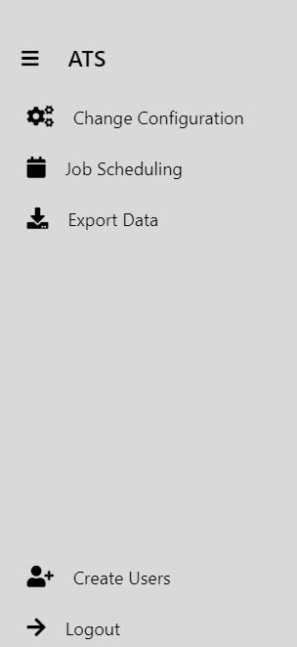
UI Implementation
Change Configuration Page
Allows admin users to add or remove stocks from the system configuration
Job Scheduling Page
Allows admin users to change what days and times jobs are run on the server
Export Data Page
Allows admin and basic users to filter and download data collected by the system
Notes:
JAKE
Before the development of the UI, managing the system was quite inconvenient:
Changing system configurations involved editing them manually
To update jobs you had to access the crontab via the command line
And you could only access collected data via the command line or phpmyadmin
To improve the accessibility of the system, we developed:
The change configuration page, which allows users to add or remove stocks from the configuration
The Job Scheduling page, which allows users to change when jobs are to be run.
And the Export page, which allows users to filter and download the collected data.
During the project demo, there will be a more detailed look at the UI and its features.

Slide 27
SCRIPTS
07
Data Collection, Data Insertion, Scheduling, Logging
Notes:
BEN

Slide 28

Scheduling Scripts
Scheduling scripts are run by crontab, this is configurable by the user using the UI.
The order in which scripts are executed is crucial to system functionality.
Notes:
BEN:
Our system currently runs all the collection and insertion scripts using bash scripts that are run by crontab. The user can change these cron jobs using the UI under the Job Scheduling tab. The order in which the scripts are executed is crucial to system functionality, the collection scripts must be run before the insertion scripts.

Slide 29
Data Collection
Collection scripts
bonds_api_query.py
company_info_api_query.py
constituent_api_query.py
historical_api_query.py
realtime_api_query.py
symbol_change_query.py
Step 1: Read Config
Step 3: Write Output File
Data Collection
The scripts read YAML configuration files to access the parameters for the query
Step 2: Process API Output
Notes:
Ben:
The collection scripts will read the YAML configuration files to retrieve the parameters for the query, the script will then load the environment variables and execute the script using the api_handler utility to retrieve the JSON output returned by the API, finally the script will process the raw data using the data_handler utility.

Slide 30
Data Insertion
Insertion scripts
symbol_change_update.py
bonds_insert.py
company_statements_insert.py
historical_commodity_insert.py
historical_index_insert.py
historical_stock_insert.py
realtime_commodity_insert.py
realtime_index_insert.py
realtime_stock_insert.py
log_insert.py
Step 1: Read Collection Output
Step 3: Executes insertion
Data Insertion
These scripts are executed immediately after their associated collection script by the scheduling scripts
Step 2: Connect to database
Notes:
Ben:
These scripts are run automatically immediately after their associated collection script by the scheduling scripts. These scripts validate each record by comparing output to expected keys, and then they check if this record already exists in the database, and if not, execute a SQL insertion statement. If a duplicate record is detected, the logger will provide a warning and the script will skip the insertion of that record.

Slide 31

Performance Estimates
Job
Symbol Change
< 1 sec
Constituent
< 1 sec
Historical (3 years worth)
~17 mins
Real time
~ 4 mins
Company Statements
~ 3 mins
Bonds
~ 5 secs
Data Deletion
< 1 sec
Notes:
Ben:
Here we can see the performance estimates for our system, these time estimates are based on our system operating on our production server which is currently running AlmaLinux 9.3. As you can see the, symbol change, constituent, bonds and data deletion jobs all run very quick. The historical and real time queries take a lot longer because they are querying the 503 constituents that make up the S&P 500 Index as well as several index composites and commodities.

Slide 32
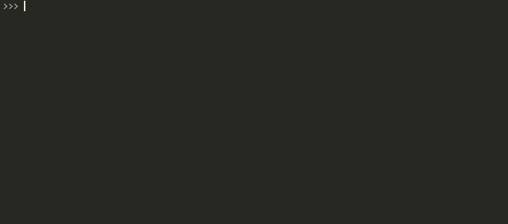
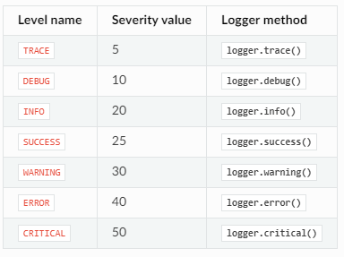

Loguru Logging
Implemented log system using Loguru
Easy to use, easy to read colorized logs
Notes:
Ben:
We decided to use loguru for our logging system due to simplicity and ease of use. The formatting is completely customizable and we can easily change the style to improve readability. We decided to implement the logging system at the debug level because we felt our project is not complicated enough to require a trace level logs.

Slide 33
Loguru Logging
Logs are colorized in terminal for readability
Logs are stored in the database for searchability/organization
The message includes line number, script and useful information for debugging/monitoring system functionality
Timestamp
Level
Message
Notes:
Ben:
The logs are clean, colorized, and stored in a table for easy filtering. Logs are created at various steps, documenting normal system function, as well as warnings for duplicate record detection which also causes the record to be skipped, and error logging for SQL related problems. And now I will hand it off to Alan.

Slide 34
TESTING
08
Collection Testing, Database Testing, Utility Testing

Slide 35
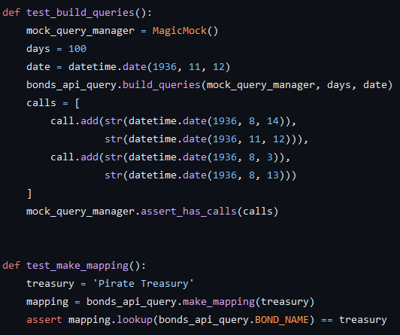
Collection Testing
These test to see if the collection scripts work correctly without sending requests to a financial API.
Functionality that is tested includes:
Query building
Field mapping
Simple raw data processing
Notes:
ALAN:
The typical collection script has functions to build queries and mappings. Only one script has data processing (symbol change query)
Tests ignore the main function in each script, since it is not responsible for manipulating data outside of calling (tested) functions and feeding the results to other functions.

Slide 36
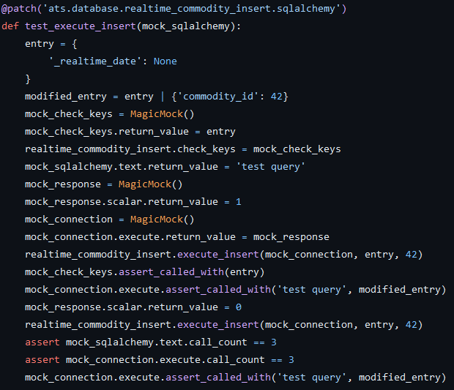
Database Testing
These test to see if the database insertion scripts work correctly, without interacting with a database.
Functionality that is tested includes:
Data processing
Entry ID retrieval
Insertion execution
Notes:
ALAN:
They ultimately check to see if the format of the data is correct for executing insertion queries using SQLAlchemy.
The main function simply calls these functions, and feeds it into the connection manager.

Slide 37
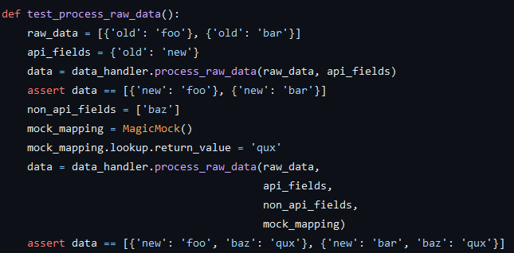
Utility Testing
These test check to see if the utility scripts work correctly, according to their intended function, without reading or writing to any data on disk.
The functionality being tested includes:
Data processing (data handler)
API querying (API handler)
File I/O (file handler)
DB connections (db handler)
Various helper objects
Notes:
ALAN:
The utility scripts contain abstracted data handling functions that are widely used by the collection and database scripts, so testing them is not only important but by proxy tests whether or not the other scripts will work as intended. This includes API handling, data processing, file I/O and database connection managing.

Slide 38
REFACTORING
09
Configuration, Source Code, Project Structure

Slide 39
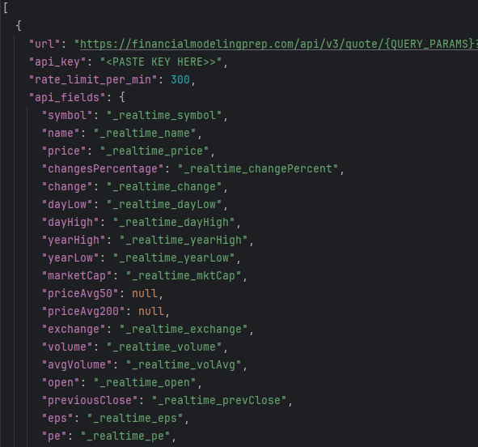
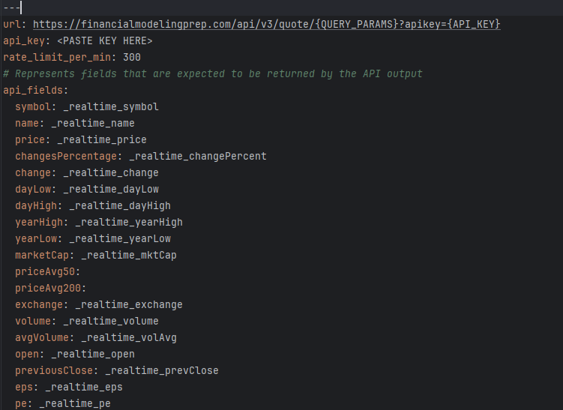
Configuration
Redesigned system configuration to use YAML format instead of JSON
Notes:
ALAN:
YAML is more widely used as a configuration filetype compared to JSON, YAML supports more data types and YAML also improves readability and adds the ability to add comments.

Slide 40
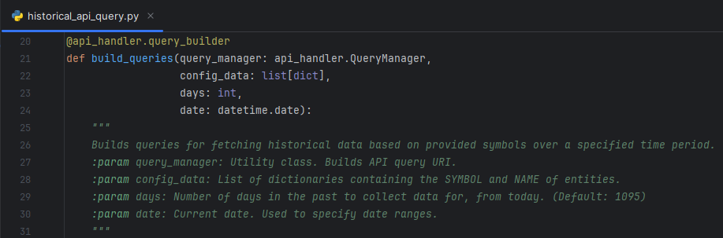
Source Code
Many scripts were rewritten to be more maintainable, cutting down on repeated code and using utility modules to handle common data manipulation tasks. Writing tests became much simpler as a result.
Notes:
ALAN
DRY, OO principles, type hints

Slide 41
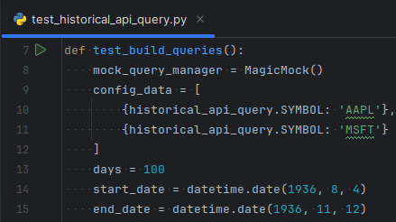
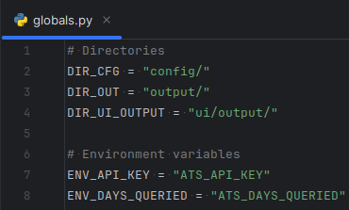
Source Code
As part of simplifying the collection and database code, other notable changes that were made includes:
Global constants file
Utility modules that handle common tasks
Flexible design
Type hints
Decorators that define shared functionality across scripts
Better config processing
Notes:
ALAN:
important constants used across many scripts were moved from individual scripts to a single file called globals.py
Utility scripts contain abstracted data retrieval and processing functionality and were made to be easily extended, allowing for new functionality to be added without affecting other code.
Type hints and decorators are used to help guide developers on how to use the abstracted functionality in the utility scripts.
Other than switching over to YAML, config files had further structural changes to simplify them and make them more readable, which improved the code used to process config data as a result.

Slide 42
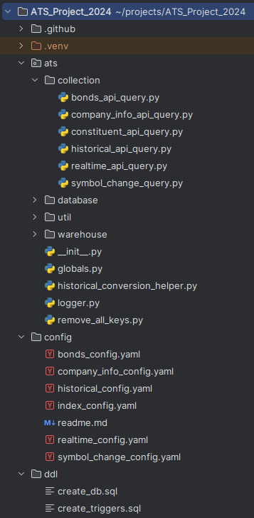
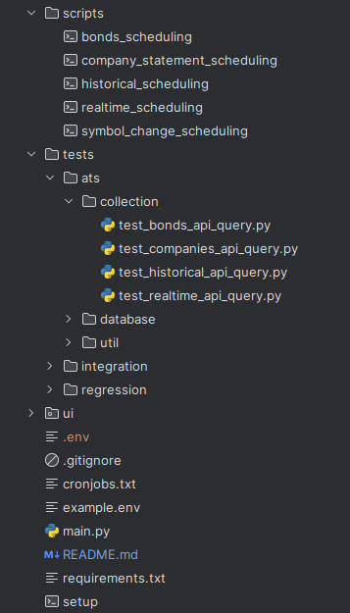
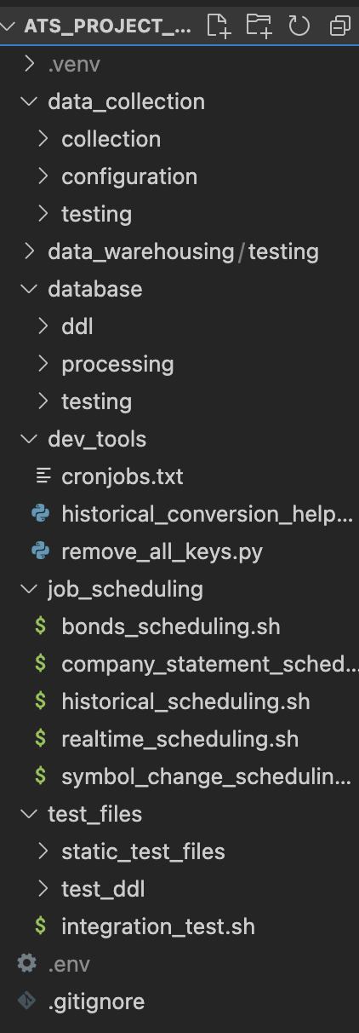
Project Structure
Notes:
VANESSA -
The entire project directory structure was rebuilt in a more logical manner, clearly separating Python scripts and modules by functionality.
Old structure: directories based on the system pipeline = data collection, database… Under each of the directories has their own testing and configuration folder.
New structure: All the configuration file is under one directory, same with the testing files. New directory for the User Interface.
By rebuilding the project directory structure, we aimed to improve navigation, readability, maintainability, and overall development productivity.

Slide 43
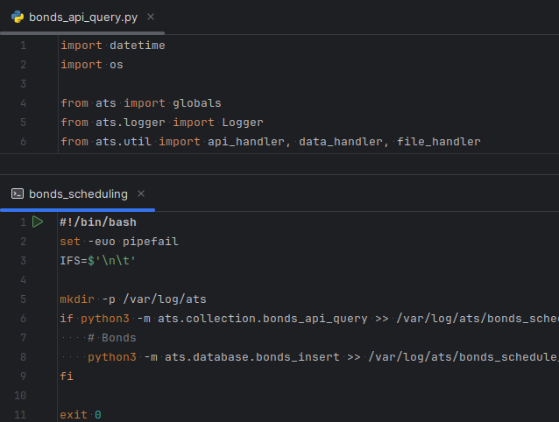
Project Structure
Notes:
VANESSA -
Likewise, scripts were adjusted to reflect the new project structure. Python scripts were changed to use absolute imports, whereas file paths in shell scripts were adjusted in a similar manner.

Slide 44
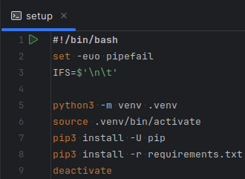
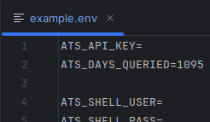
Project Structure
Project setup
Python-dotenv package
Notes:
VANESSA
Setting up the project locally was simplified as well. A shell script to automate the process. This simplification enables us to quickly initialize the project environment without altering system configurations.
Sensitive information, such as API keys and database login credentials, has been protected using the python-dotenv package. These details are now stored in an environment variables file that is loaded at runtime, ensuring they remain confidential and are excluded from version control.

Slide 45
LESSON LEARNED
10
Project Management, Collaboration & Release Notes
Notes:
Vanessa - now i will be sharing to you the things that we've learned throughout our project.

Slide 46
Project Management
Collaboration
Clear tasks and realistic goals
Documentation
Software Engineering
Well-defined roles
Stand ups
Time management
Version control
Seeking guidance
Notes:
VANESSA
When planning, Clear tasks and goals for each sprint are really important: This helps us understand what needs to be prioritized and accomplished. Having realistic goals helps us reducing stress levels.
Documentation: Updating the documentations while working on the project not only prevents us cramming the final week of the semester, but it also ensures that team members are on the same page with the current or ongoing changes in the project.
Software Engineering: We learned the importance of creating system that is not only reliable and efficient but also sustainable. It’s not just about designing, coding, and calling it a day once it works.
Well defined-role: Having a well-defined role helps maintain team harmony. Each team member was working with their own tasks and things are being done. This promotes teamwork and efficiency.
Stand ups: Improves communication and transparency among team members. Keeps everyone informed about progress and any potential roadblocks.
Time management: The importance of maintaining a healthy school-work-life balance. Team members are not as overworked. Overworked = stressed = unproductive.
Version control: We learned the importance of having proper version control and github usage. Best practices like using specific branches reduces the likelihood of conflicts or errors.
Seeking guidance from other people: Throughout our project, We learned that seeking guidance from experts, whether they were within our team, professors, coworkers, or other experienced individuals, was crucial. This approach not only helped us make more informed decisions but also enabled us to avoid potential crises by tapping into the experience and insights of those with more experience.

Slide 47
Release Notes
Version 2.0
April 10, 2024
Finish up major project refactoring
Fixed bugs associated with refactor
Scheduling changes/improvements
Improved UI functionality
Lots of bug fixes/improvements
System now deploys to a web server and can be accessed through a browser
ATS now available externally https://ats.cosc-oc.ca/login
Notes:
Vanessa - the Final update of our project…. It includes: ….

Slide 48
PROJECT DEMO
11
Notes:
Vanessa -
Now for the Project Demo

Slide 49

DEMO VIDEO
Notes:
Vanessa - We've produced a video showcasing the usage of our user interface. In this video, Jake will walk you through the features and functionality of our interface.

Slide 50
Questions?

